Slide 1



GROUP 3
THE CampusExpense Manager application

Slide 2

MEMBERS
01
NGUYEN MINH HIEU
02
NGUYEN TIEN MANH
03
BUI HOANG LONG
04
PHAM XUAN BACH

Slide 3
CONTENT
01
STAKEHOLDERS
02
FUNCTIONAL AND NON-FUNCTIONAL REQUIREMENTS
03
DIFFICULTIES OF THE PROJECT
04
PLATFORM USED AND FEATURES
05
ANALYZE HIDDEN RISKS

Slide 4
INTRODUCTION
BudgetWise Solutions is a small development team with limited experience in mobile app development. They have taken on a project to create a mobile application called "CampusExpense Manager," tailored specifically for university students.
The CampusExpense Manager application aims to support college students in effective financial management. By simplifying the spending tracking and budgeting process, the app hopes to help students make informed financial decisions and maintain financial stability throughout their studies.

Slide 5



STAKEHOLDERS
Students
Budgetwise Solution team
University administration
Investor
Students

Slide 6


Students
Role: Students will be the main users of the application, using it to track and manage their daily expenses throughout their studies. They will interact directly with the app's features to ensure that it meets their needs effectively.
Goals and needs: The main goal of students is to manage spending appropriately so as not to fall into debt during their studies. They need a tool that helps them budget, track spending, and make smart financial decisions to maintain financial stability.
Contributions: Students can provide feedback and ideas during the app testing process, helping the development team better understand what they need and want. Their participation in testing and providing feedback will be invaluable in improving the quality of the product.
Challenges: Some students may have difficulty accessing technology or lack time to use the application due to their busy study schedule. Additionally, they may feel hesitant to change their financial management habits.

Slide 7

Budgetwise Solution team
Role: The BudgetWise Solutions team consists of approximately 5-6 members, each taking on a specific role in the application development process. Members may include programmers, user interface designers, testers, and project managers, all working toward the common goal of creating a high-quality product for the customer. student.
Goals and needs: The team's goal is to develop an effective expense management application that meets students' needs in tracking and managing personal finances. They need to have a clear understanding of the end user's needs and challenges to design relevant and useful features in the application.
Contribution: Each team member will contribute their own skills and expertise to the project. Programmers will develop the source code, designers will create attractive user interfaces, and testing experts will ensure that the application works smoothly and without errors before launch.
Challenges: The team may face challenges such as time and budget constraints, as well as inexperience in mobile application development. They also need to manage effective communication between members to ensure that everyone is on track and in sync with the development process.

Slide 8
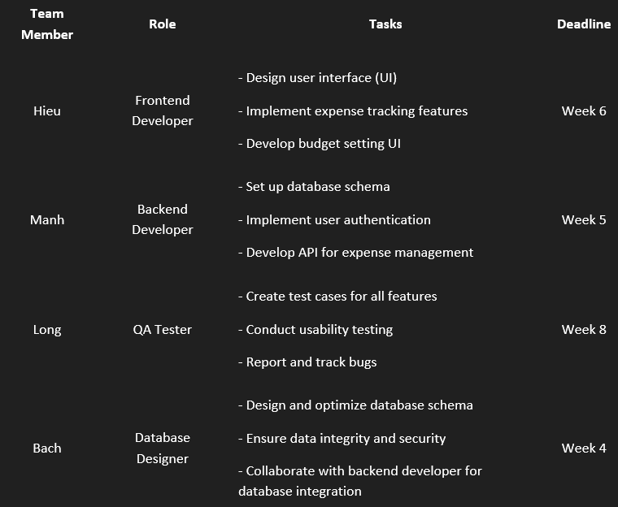
Divide the work of the BudgetWise team

Slide 9

University administration
Role: The Board of Directors, including the principal and vice principals, is responsible for managing and operating the university's activities. They will serve as key stakeholders in approving and supporting the "CampusExpense Manager" application development project, ensuring that the application is aligned with the school's educational and financial goals.
Goals and needs: The main goal of the Board of Directors is to enhance the learning experience for students and support them in personal financial management. They needed an app that would help students track spending and budget, thereby easing financial pressure and facilitating more effective learning.
Contribution: The School Board can provide financial resources and policy support for the project. They can also connect the development team with experts in the fields of finance and education to ensure that the application properly meets the needs of students.
Challenges: One of the major challenges the Board of Directors may face is balancing a limited budget with the growing needs of students. They also need to ensure that the application complies with applicable regulations and educational standards.

Slide 10

Investor
Role: Mr. Long Ma is a strategic investor who will provide the necessary capital for the application development project "CampusExpense Manager". With extensive experience in the field of technology investment, he will play an important role in directing and financially supporting the development team.
Objectives and needs: Mr. Long's goal is to invest in projects with high growth potential, especially applications serving the needs of students. He looks for investment opportunities that can bring sustainable profits and contribute positively to the education community.
Investment: Mr. Long decided to invest 250 million VND in the project. This investment will be used for application development, marketing, and other support activities to ensure the success of the project.
Contribution: In addition to providing capital, Mr. Long can also share his experience and knowledge in the fields of startups and product development. He can connect the development team with potential partners and markets, helping to expand the project scale.
Challenges: One of the challenges that Mr. Long may face is accurately assessing the application's potential in a competitive market. He needs to consider factors such as market trends, user needs and application competitiveness.
Mr. Long Ma

Slide 11
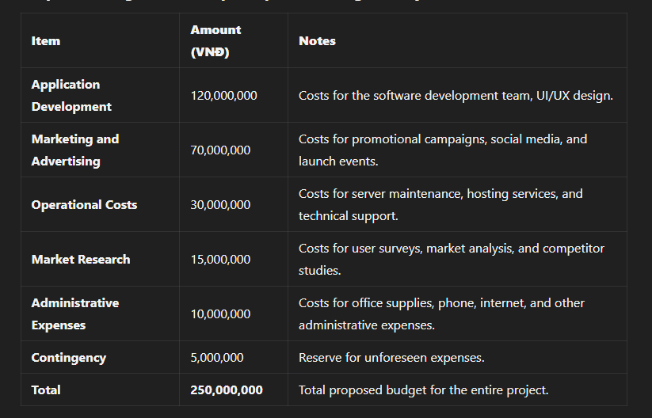
Estimated budget for the CampusExpense Manager Application project

Slide 12
Estimated budget for the CampusExpense Manager Application project
Detailed Explanation
Application Development: This is the largest expense, covering salaries for developers, designers, and IT specialists. This amount ensures that the application is developed with high quality and meets user needs.
Marketing and Advertising: To attract users, an effective marketing campaign is essential. This budget will be used to promote the application on social media platforms and organize events to introduce the app to students.
Operational Costs: After the application is launched, there will be ongoing costs to ensure that it runs smoothly and provides technical support to users.
Market Research: Conducting surveys and research is crucial to understand user needs and preferences.
Administrative Expenses: This includes daily expenses to maintain the operations of the development team and office.
Contingency: It is always necessary to have a reserve for unexpected situations that may arise during the development and deployment of the application.

Slide 13

Functional Requirements
User Registration & Authentication
Expense Tracking
Secure account creation and login to access personal expense data.
Add, edit, and categorize expenses with details (description, date, amount, category).
Budget Setting
Expense Overview
Set and adjust monthly budgets for categories (e.g., food, entertainment).
Summarize monthly expenses, remaining budget, and category breakdowns.
Display expense trends over time.

Slide 14
Functional Requirements
Recurring Expenses
Expense Reports
Add recurring expenses with start/end dates, automatically included in monthly budget.
Generate detailed reports by time period (e.g., monthly, annually) with category breakdown.
Expense Notifications
Send reminders when approaching or exceeding budget limits.

Slide 15
Non-Functional Requirements
Performance
User-Friendly Interface
Smooth, responsive user experience, even with extensive data.
Intuitive design with clear labels and easy navigation.
Platform Compatibility
Available on both Android and iOS.

Slide 16
Non-Functional Requirements
Data Security
Feedback and Support
Secure storage with encryption, adherence to data privacy standards.
In-app feedback form; team actively monitors and addresses user feedback.
Monetization (Optional)
Future updates may include in-app ads or premium features; prioritize core functionality first.

Slide 17

Project difficulties how to overcome expense management system
Limited Experience
Scope Creep
Description: The development team has limited experience in mobile app development, which can lead to challenges in understanding best practices and optimizing the development process.
Impact: This may result in longer development times, increased errors, and potential rework.
Description: As stakeholders provide feedback, there may be a tendency to add new features or change requirements.
Impact: This can extend the timeline and strain resources, making it difficult to meet the original project objectives.
Tight Timeline
Technical Challenges
Description: The project has a strict 12-week timeline from concept to launch.
Impact: This may lead to rushed development, inadequate testing, and potential compromises on quality if not managed effectively.
Description: Integrating various technologies and ensuring compatibility between iOS and Android platforms can be complex.
Impact: Technical issues may arise, leading to delays and requiring additional resources for troubleshooting.

Slide 18
Difficulties of the project
Data Security and Privacy
Resource Constraints
Description: Ensuring the security of user data and compliance with data protection regulations (e.g., GDPR) is critical.
Impact: Implementing adequate security measures may require additional time and expertise, potentially impacting the project timeline.
Description: The project operates with a limited budget and a small team, which can restrict the scope of development and marketing efforts.
Impact: This can lead to compromises in features, marketing strategies, and overall project quality.
Offline Functionality
Feedback Management
Description: Ensuring the app functions effectively without an internet connection adds complexity to the design and development.
Impact: This may require additional development effort and testing to ensure data synchronization when connectivity is restored.
Description: Collecting and implementing user feedback effectively is essential for improving the app.
Impact: Poorly managed feedback processes can result in misaligned features and user dissatisfaction.

Slide 19
strategy to overcome difficulties
Limited Experience
Scope Creep
Training and Workshops: Invest in training sessions and workshops on mobile development best practices and tools.
Mentorship: Pair less experienced developers with seasoned mentors who can provide guidance and support.
Incremental Learning: Start with smaller, less complex features to allow the team to build confidence and skills progressively.
Change Control Process: Establish a formal process for evaluating and approving changes to the project scope, including impact assessments.
Clear Requirements Documentation: Ensure that project requirements are well-documented and agreed upon at the start to minimize misunderstandings.
Stakeholder Engagement: Regularly communicate with stakeholders to manage expectations and clarify priorities.
Tight Timeline
Agile Methodology: Adopt an Agile approach to break the project into manageable sprints, allowing for regular assessments and adjustments.
Prioritization: Focus on core functionalities first, deferring non-essential features to later phases or updates.
Regular Milestones: Set clear milestones and deadlines to keep the team accountable and ensure steady progress.

Slide 20
Strategy to overcome difficulties
Technical Challenges
Resource Constraints
Technology Research: Conduct thorough research on the best tools and frameworks for cross-platform development (e.g., React Native, Flutter).
Prototyping: Create prototypes to test integrations early in the development process and identify potential issues.
Continuous Testing: Implement automated testing to catch technical issues early and ensure consistent performance across platforms.
Lean Development: Adopt lean principles to maximize efficiency, focusing on delivering value with minimal waste.
Outsource Where Necessary: Consider outsourcing specific tasks (e.g., UI/UX design) to experts to improve quality without overextending the team.
Prioritize Features: Identify the most critical features that deliver the highest value to users and prioritize those within the budget.
Data Security and Privacy
Security Best Practices: Follow industry best practices for data encryption, secure authentication, and data storage.
Regular Audits: Conduct regular security audits and vulnerability assessments to identify and address potential risks.
Compliance Training: Provide training on data protection regulations to ensure the team understands compliance requirements.

Slide 21
Strategy to overcome difficulties
Feedback Management
Feedback Mechanism: Implement an in-app feedback feature to gather user insights easily.
Regular Reviews: Schedule regular review sessions to analyze feedback and determine actionable improvements.
Iterative Development: Use feedback to inform iterative updates, ensuring continuous improvement of the application.
Offline Functionality
Local Storage Solutions: Use local databases (e.g., SQLite) to store data on the device, enabling offline access and functionality.
Data Synchronization: Implement data synchronization processes to update the server when the device is back online.
User Testing: Conduct thorough testing in offline scenarios to ensure seamless user experience.

Slide 22

Platform Used
Android: The app will be developed for Android devices to reach a large user base, as many students use Android smartphones.
iOS: Developing for iOS ensures accessibility for users who prefer Apple devices, allowing the app to cater to a wider audience.

Slide 23
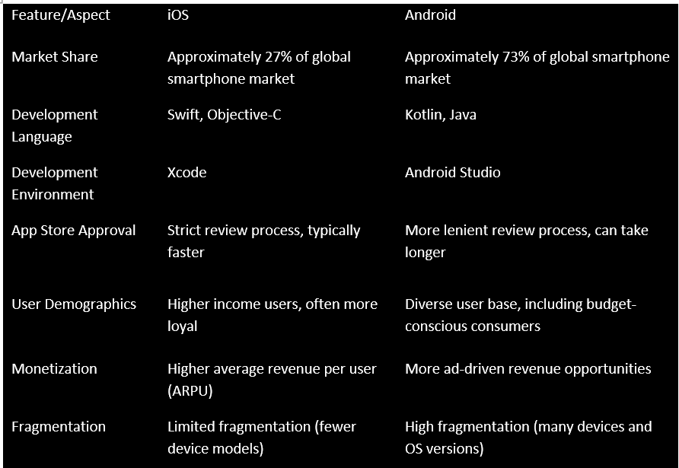
Comparison table of ios and android

Slide 24
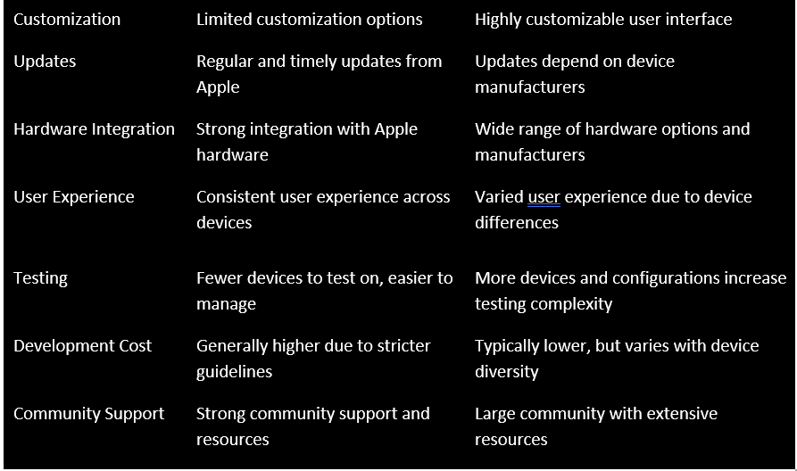
Comparison table of ios and android

Slide 25
Required Features
1.User Registration and Login
Enables users to create accounts with usernames and passwords.
Ensures information security and allows logins to access spending data.
2. Spending Tracking
Allows users to add, edit, and categorize spending items (e.g., rent, groceries).
Each transaction should have a description, date, amount, and category for easy management.

Slide 26
Required Features
3. Set Up a Budget
Users can set up monthly budgets for each spending category and change them as needed.
4. Spending Overview
Displays total monthly spending, budget balance, and breakdown by category.
Enables review of spending trends over time.

Slide 27
Required Features
5. Recurring Spending
Enables setting up recurring expenses (e.g., monthly rent) with start and end dates.
Automatically updates recurring expenses to monthly budgets.
6. Spending Reports
Generate detailed reports over time periods (e.g. monthly, yearly), analyzing spending by category.

Slide 28
Required Features
7. Budget Notifications
Send notifications when users are close to or over their budget for a category, helping to control spending.

Slide 29


Business application solutions
01
02
03
Mobile Application (Primary Solution)
Desktop Application
Web Application

Slide 30
Mobile Application (Primary Solution)
Platform: Android
Description: A mobile application is the most suitable solution for students who are constantly on the go. It allows users to track expenses in real-time, set budgets, and receive notifications directly on their smartphones.
Tool : android studio
Key Features:
User-friendly interface with intuitive navigation.
Secure user registration and authentication.
Expense tracking with categorization.
Budget setting and adjustment functionalities.
Recurring expense management.
Expense reports generation.
Notifications for budget limits.
Benefits:
Accessibility and convenience for users.
Real-time updates and notifications.
Offline functionality to cater to students with limited connectivity.

Slide 31
Desktop Application (Optional Solution)
Features:
Local Storage: Allow users to store data locally with an option to sync with the cloud.
Comprehensive Reporting: Provide advanced reporting features for detailed financial analysis.
Integration with Other Tools: Allow integration with spreadsheet software for exporting data.
Advantages:
Performance: Desktop applications can handle larger datasets more efficiently.
Offline Capability: Users can manage expenses without needing an internet connection.

Slide 32
Web Application (Supplementary Solution)
Platform: A responsive web application that complements the mobile app.
Features:
Similar functionality to the mobile app, allowing users to manage expenses from a desktop.
Data synchronization between mobile and web platforms.
Benefits:
Broader accessibility for users who prefer desktop usage.
Enhanced data visualization capabilities on larger screens.

Slide 33
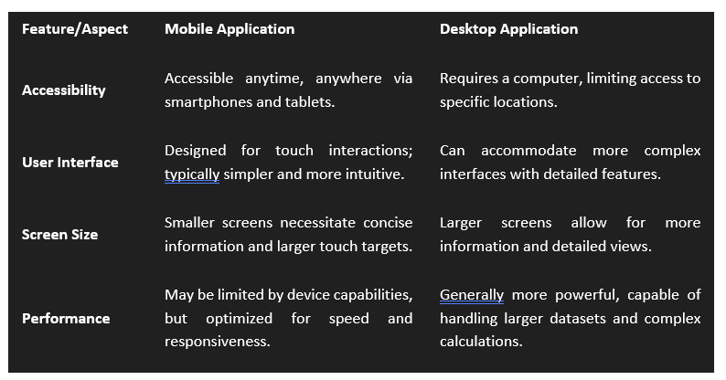
Comparison between mobile
and desktop applications :

Slide 34
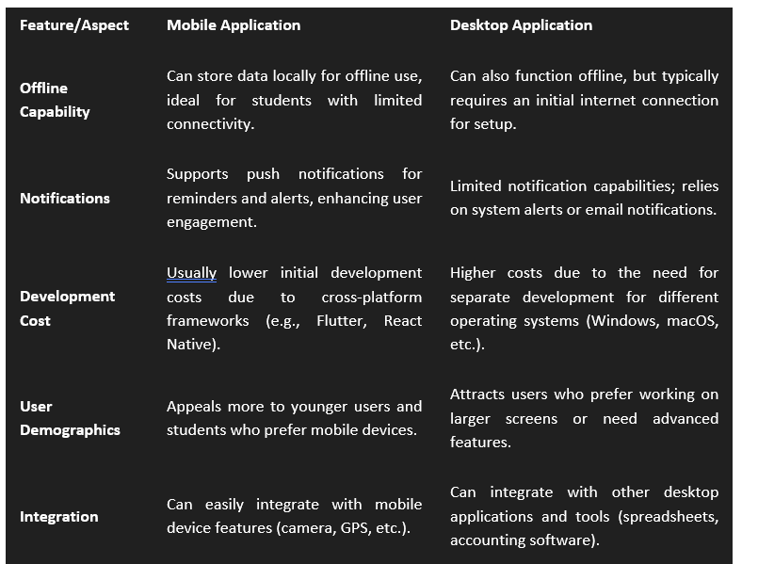

Slide 35
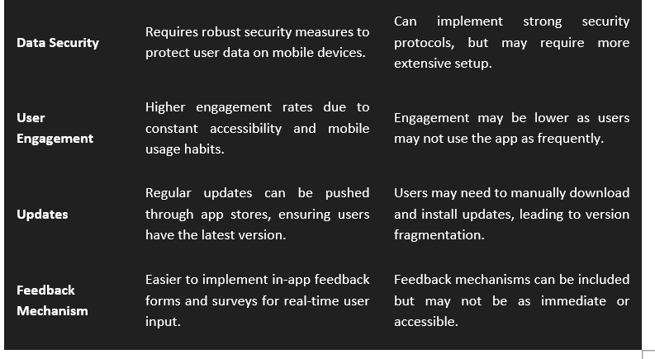

Slide 36
Potential risks in project implementation and how to manage risks

Slide 37
Platform compatibility risks
Description: The project requires the app to work on both Android and iOS platforms, which requires a lot of testing and optimization time, which can lead to compatibility issues.
How to manage:
Develop for each platform or use a cross-platform framework: Consider cross-platform frameworks like React Native to reduce development time.
Cross-device testing: Use real devices or emulated platforms to test compatibility regularly throughout the development process.
Minimize platform-dependent features: Limit features that may be platform-dependent to simplify testing and development.

Slide 38
Risks regarding financial resources and additional costs
Description: With a limited budget, any unexpected costs can affect project progress and quality.
How to manage:
Estimate additional costs: Allocate a reserve budget for unplanned costs.
Choose cost-effective tools and services: Consider free or low-cost tools and services that fit your project's needs.
Closely monitor costs: Evaluate actual costs against expectations regularly to make timely adjustments.

Slide 39
Data security and privacy compliance risks
Description: The application will store users' financial data, so it needs to comply with data security regulations. Security flaws can cause loss of trust from users and affect company reputation.
How to manage:
Data encryption: Use encryption measures for sensitive data both in transmission and in storage.
Regular security testing: Perform regular security checks to ensure there are no vulnerabilities.
Security training: Train the team on security standards and user data protection regulations.

Slide 40
Risks regarding project completion time
Description: The project had a deadline of only 12 weeks from start to launch, a fairly short period of time for an inexperienced team.
How to manage:
Detailed planning: Make detailed plans for each stage and closely monitor progress.
Using Agile development method: Applying Agile development method helps the team work effectively, receive feedback and continuously adjust the product in each stage.
Prioritize key functions: Focus on completing key functions (like tracking spending and setting budgets) before developing additional features.

Slide 41

GROUP 3
THANK YOU

